Slide 1
Digital Control Architecture with Tight Voltage Regulation-VHDL implementation
Final Project for EE533
Professor : Dr. Rachid Beguenane
Xiang Zhang

Slide 2
Content
Application and Background
Digital Control System Overview
Determine the resolution of ADCs
Controller architecture Overview
DPWM implementation
Period Calculator implementation
Multi-phase Control Unit implementation
Control Unit with AVP technique FSM algorithm
Assembling the digital controller
Conclusion

Slide 3
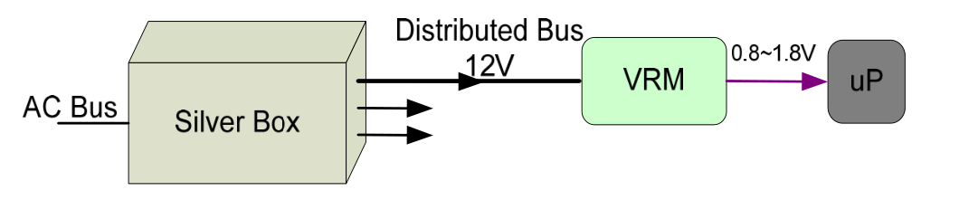
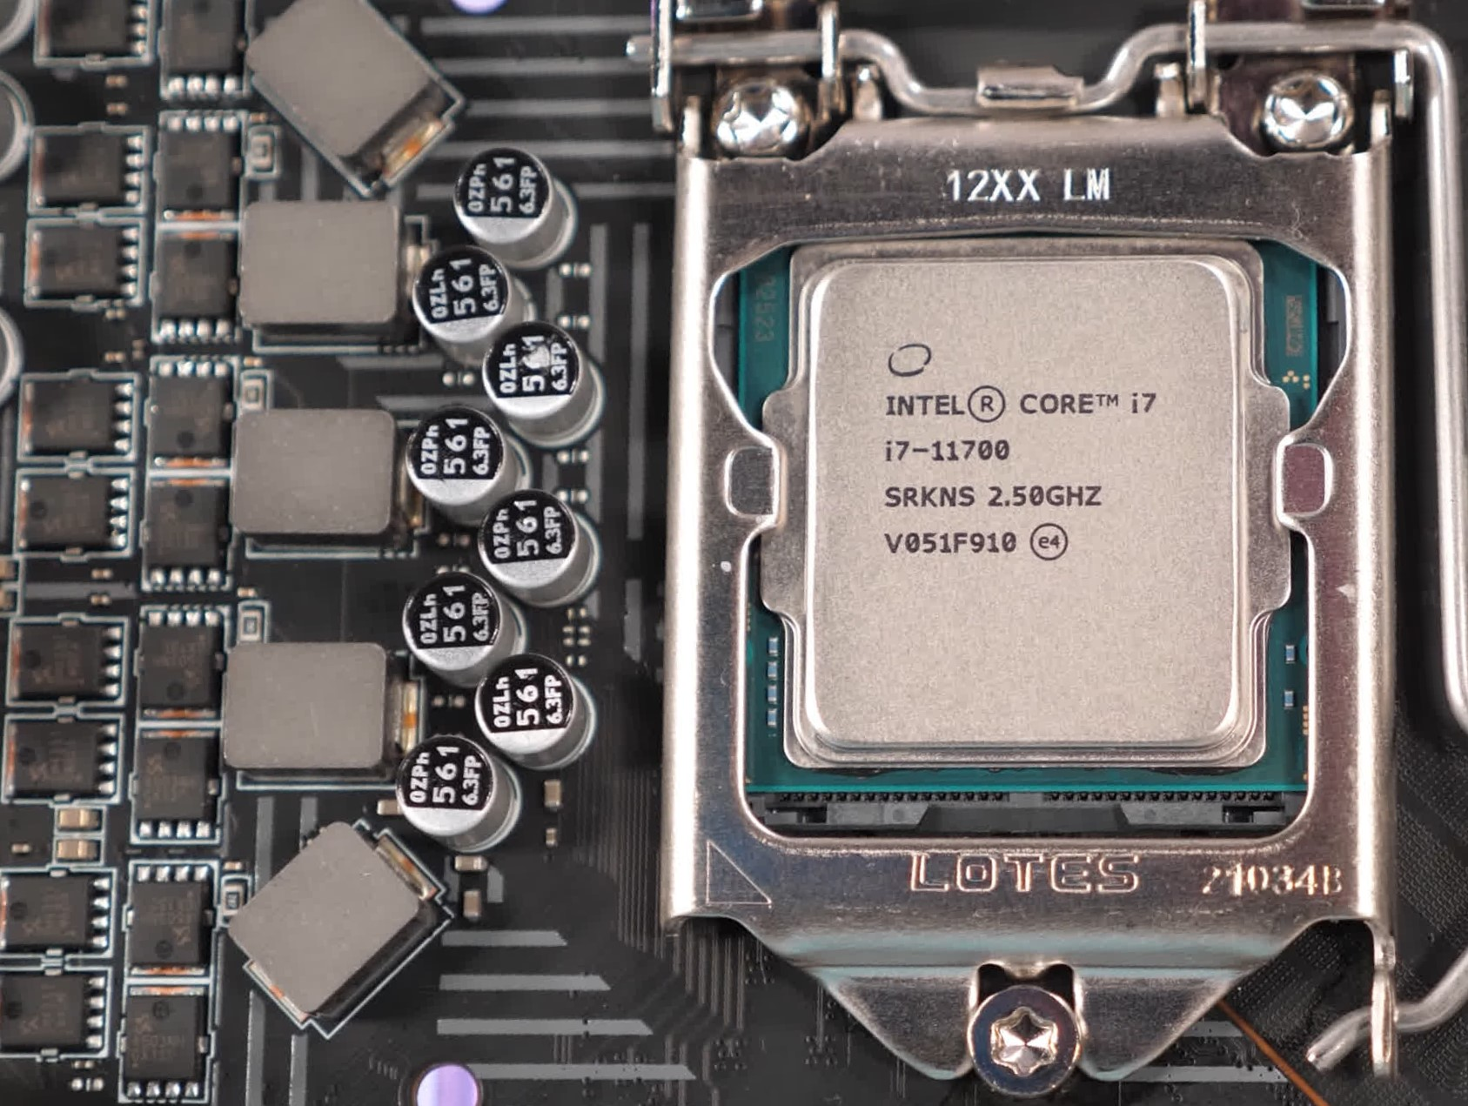
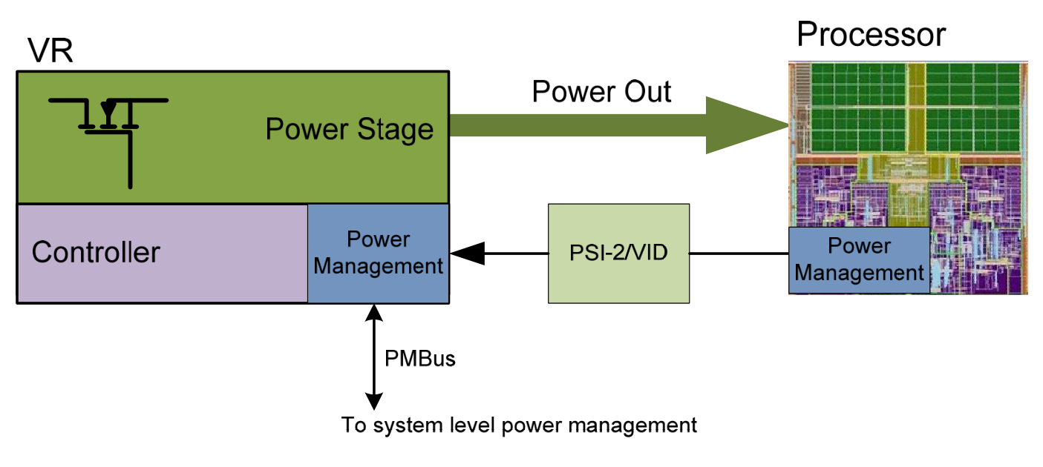
Application and Background
Phase 1
Voltage regulator
Multi-phase Buck
Phase 2
Phase 3
Phase 4
Approximate 100A
Phase 5
Illustration of Power management for modern processors
Processor and Socket
$$Power=Constant∗Frequency∗Voltage^{2}$$
Voltage regulator of modern processor
In some area, voltage tracking is very strict, requiring high dynamic responds, e.g. modern computer processors’ voltage regulator;
Dealing with different working-load, voltage is reconfigurable , e.g. tile up/down the voltage of the processor for overclocking to obtain better performance, intel turbo-boost;
Multi-phase and interleaving techniques is required for all conditions

Slide 4
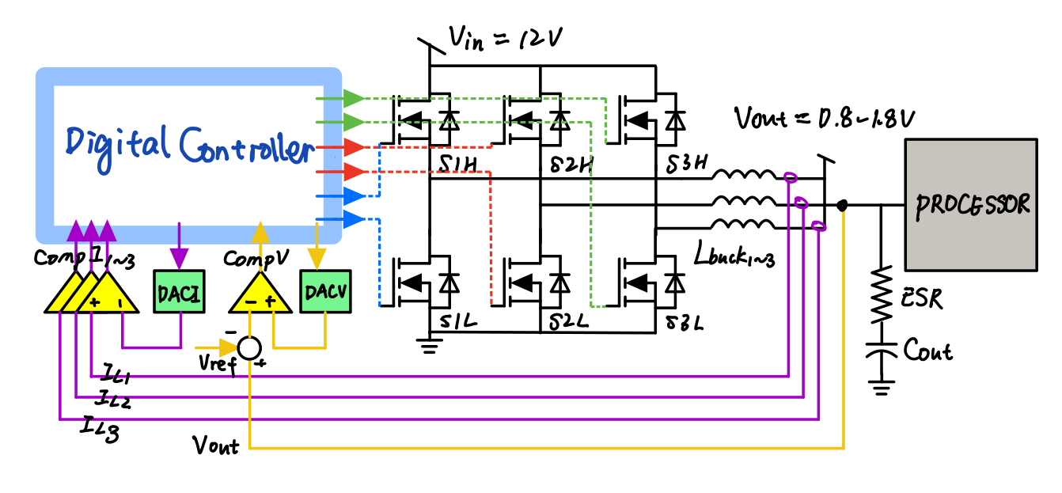
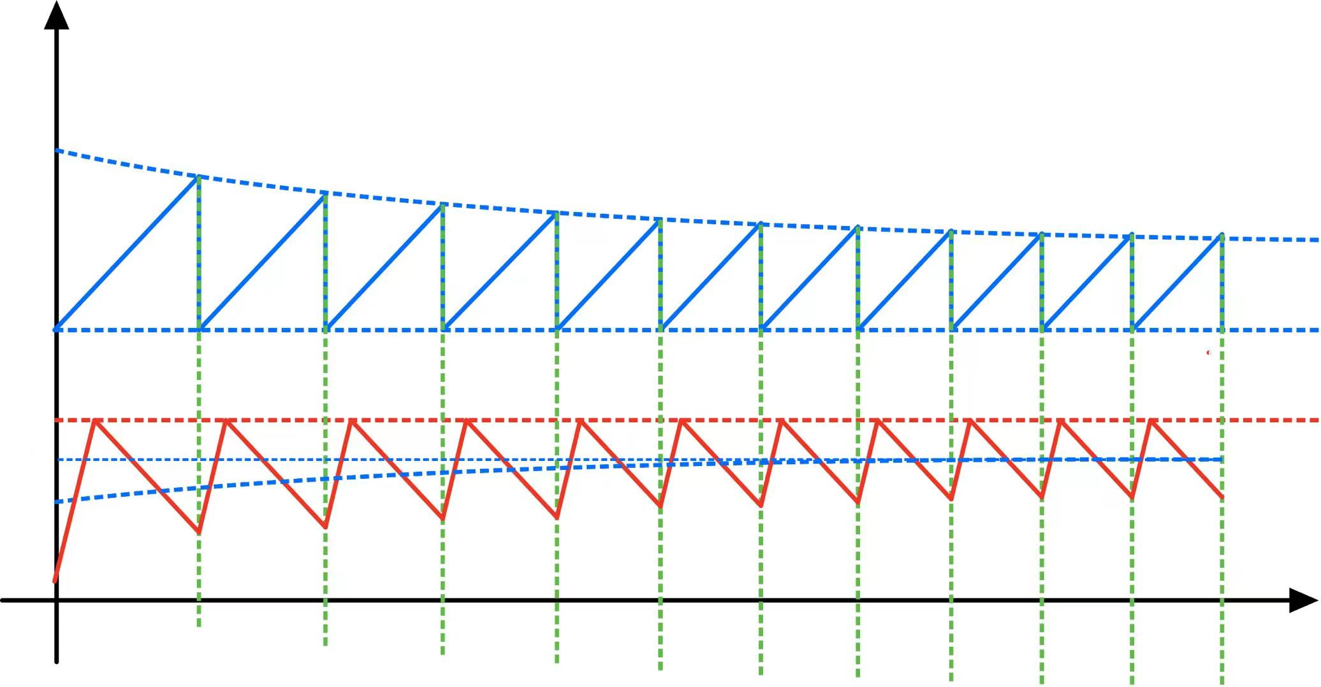







Digital Control System Overview
$$V_{err}=V_{out}−V_{ref}$$
$$V_{DACV}$$
$$V_{low}$$
$$I_{L}$$
$$\frac{ΔI}{2}$$
$$I_{pk}$$
$$I_{L_avg}$$
Simplified block diagram of the control architecture
Current and voltage waveform during small load transient
Most digital control techniques use high resolution internal ADC (Analog-to-digital converter) and comparator , which results in a large core size and a high cost;
Proposed Technique use external DAC and analog comparator, cost-friendly;
Digital controller combines current programmed control and variable frequency operation
In small load transient, converter works in variable frequency operation
$$I_{L_avg}=I_{out}=I_{pk}−\frac{ΔI}{2}+τ\frac{V_{out}\left(1−D \right)}{LD}=I_{pk}−\frac{V_{out}\left(1−D \right)}{2{L f}_{s}}+τ\frac{V_{out}\left(1−D \right)}{LD}$$
[1] S. Saggini, M. Ghioni, and A. Geraci, “An innovative digital control architecture for low-Voltage, high-current DC-DC converters with tight voltage regulation,” IEEE Transactions on Power Electronics, vol. 19, no. 1, pp. 210–218, Jan. 2004, doi: 10.1109/TPEL.2003.820543.

Slide 5
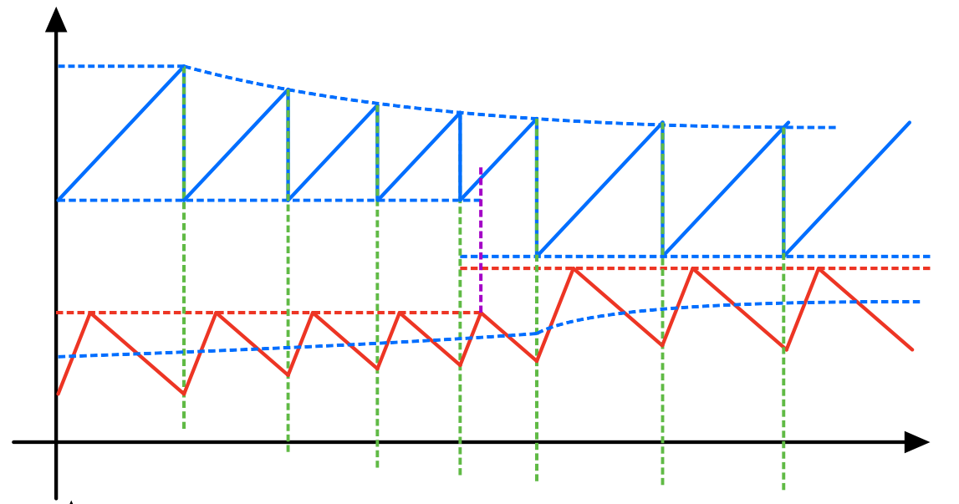
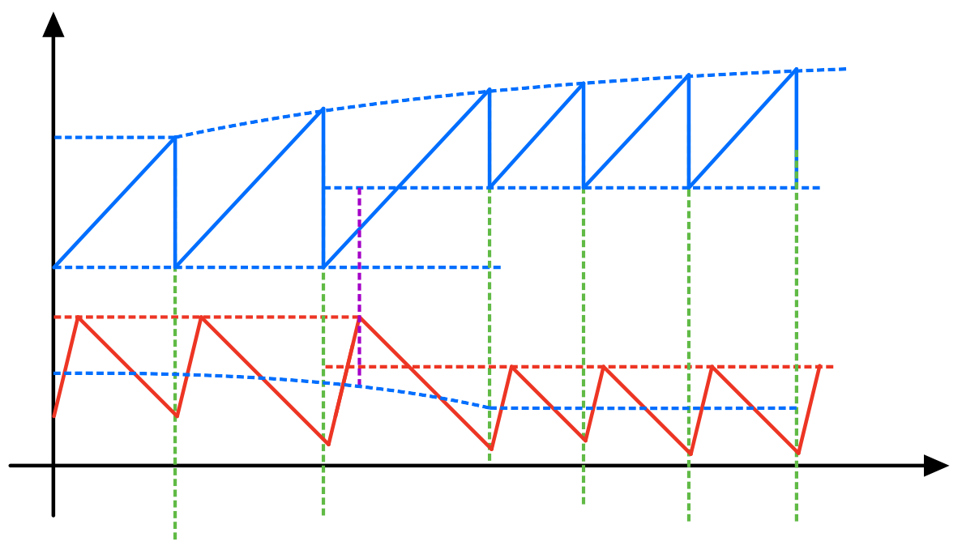



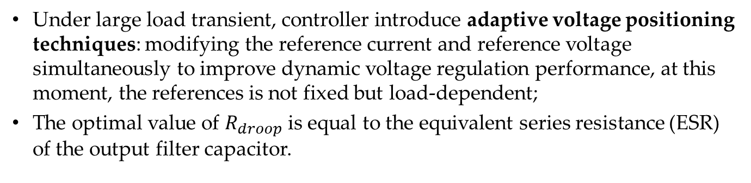


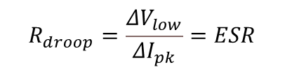
Digital Control System Overview
In large load transient, converter works in current programmed control
$$V_{DACV}$$
$$ΔV_{low}$$
$$V_{DACV}$$
$$ΔV_{low}$$
$$ΔI_{pk}$$
$$ΔI_{pk}$$
$$I_{L}$$
$$I_{L}$$
Current and voltage waveform during large heavier load transient
Current and voltage waveform during large lighter load transient
$$V_{out}=V_{ref}−R_{droop}∗I_{out}$$
Under large load transient, controller introduce adaptive voltage positioning techniques: modifying the reference current and reference voltage simultaneously to improve dynamic voltage regulation performance, at this moment, the references is not fixed but load-dependent;
The optimal value of $R_{droop}$ is equal to the equivalent series resistance (ESR) of the output filter capacitor.
$$R_{droop}=\frac{ΔV_{low}}{ΔI_{pk}}=ESR$$

Slide 6
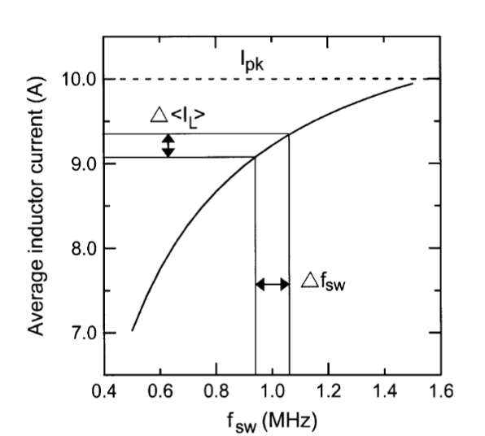



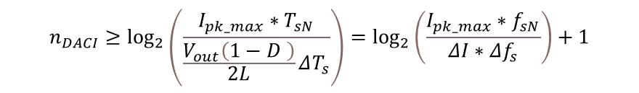


Determine the resolution of ADCs
Determine the current DAC (DACI)
According to the variable frequency operation principle, the average current varied with switching frequency (see page 4)
$${(I}_{L_avg})$$
$$\left|ΔI_{L_avg}\right|=\frac{V_{out}\left(1−D \right)}{2L}ΔT_{s}≥LSB_{DACI}$$
$$Δf_{s}$$
The main idea: DAC should be precise enough to make the least frequency variation detectable
In other word: the least significant bit (LSB) of DAC should smaller enough to overlap the smallest current variation
Average inductor current as a function of switching frequency
$${LSB}_{DACI}=\frac{I_{pk_max}}{2^{n_{DACI}} }$$
$$n_{DACI}≥\log_{2}\left(\frac{15.4A∗1Mhz}{4A∗\left(±5\%∗1Mhz\right)}\right)+1=7.266$$
Therefore, the resolution of current DAC can be calculated:
$$n_{DACI}≥\log_{2}\left(\frac{I_{pk_max}∗T_{sN}}{\frac{V_{out}\left(1−D \right)}{2L}ΔT_{s}}\right)=\log_{2}\left(\frac{I_{pk_max}∗f_{sN}}{ΔI∗Δf_{s}}\right)+1$$

Slide 7
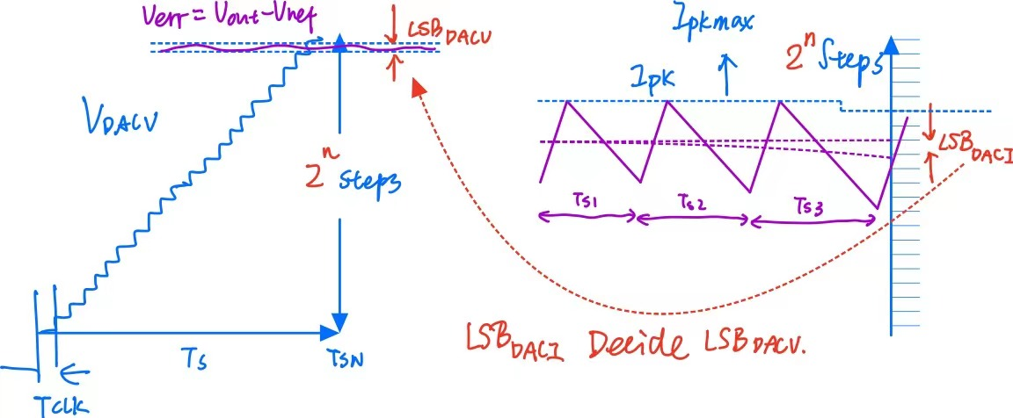
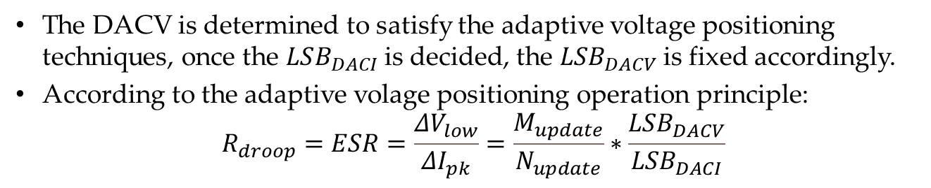
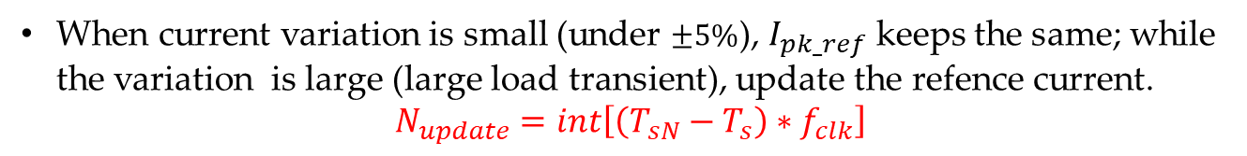
Determine the resolution of ADCs
Determine the volage DAC (DACV)
Relationship between ${LSB}_{DACV}$ and ${LSB}_{DACI}$
The DACV is determined to satisfy the adaptive voltage positioning techniques, once the $LSB_{DACI}$ is decided, the $LSB_{DACV}$ is fixed accordingly.
According to the adaptive volage positioning operation principle:
$$R_{droop}=ESR=\frac{ΔV_{low}}{ΔI_{pk}}=\frac{M_{update}}{N_{update}}∗\frac{{LSB}_{DACV}}{{LSB}_{DACI}}$$
When current variation is small (under $±5\%$), $I_{pk_ref}$ keeps the same; while the variation is large (large load transient), update the refence current.
$$N_{update}=int\left[\left(T_{sN}−T_{s}\right){∗f}_{clk}\right]$$

Slide 8
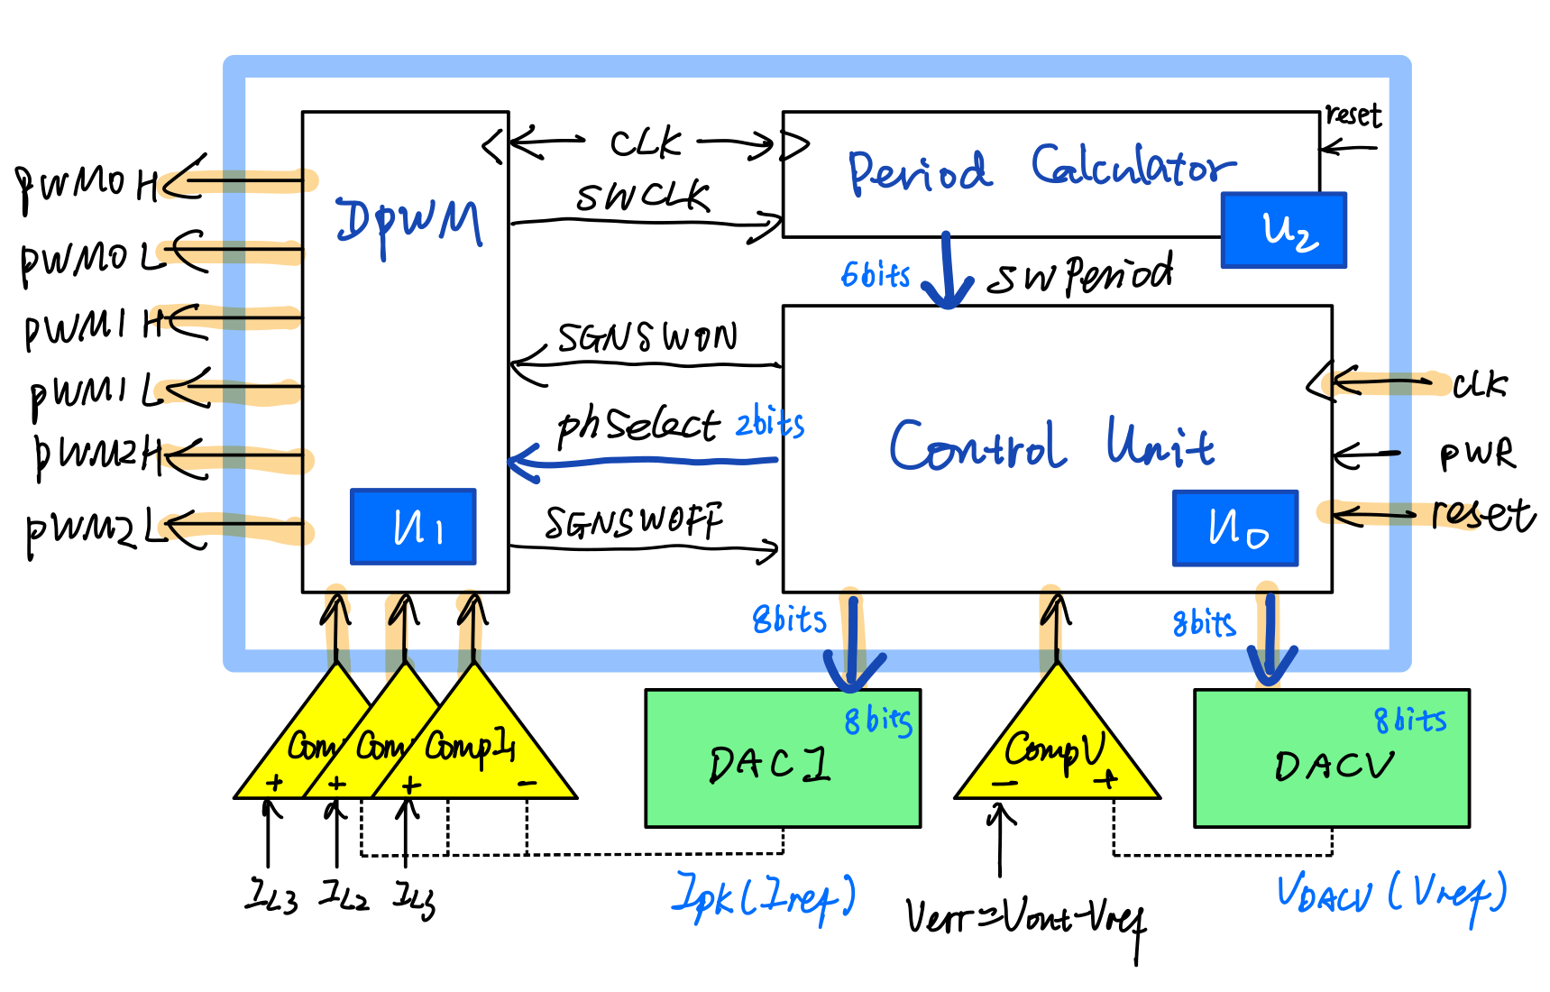
Controller architecture Overview
Digital Controller architecture proposed in the lecture
The digital controller consist of three components, DPWM generator, Switching Period Calculator, and Control Unit;
The DPWM is similar as the Datapath in traditional special purposed processor, and the Control Unit can be translated to a Finite State Machine.
[1] S. Pan and P. K. Jain, “A New Digital Adaptive Voltage Positioning Technique with Dynamically Varying Voltage and Current References,” IEEE Transactions on Power Electronics, vol. 24, no. 11, pp. 2612–2624, 2009, doi: 10.1109/TPEL.2009.2030807.

Slide 9
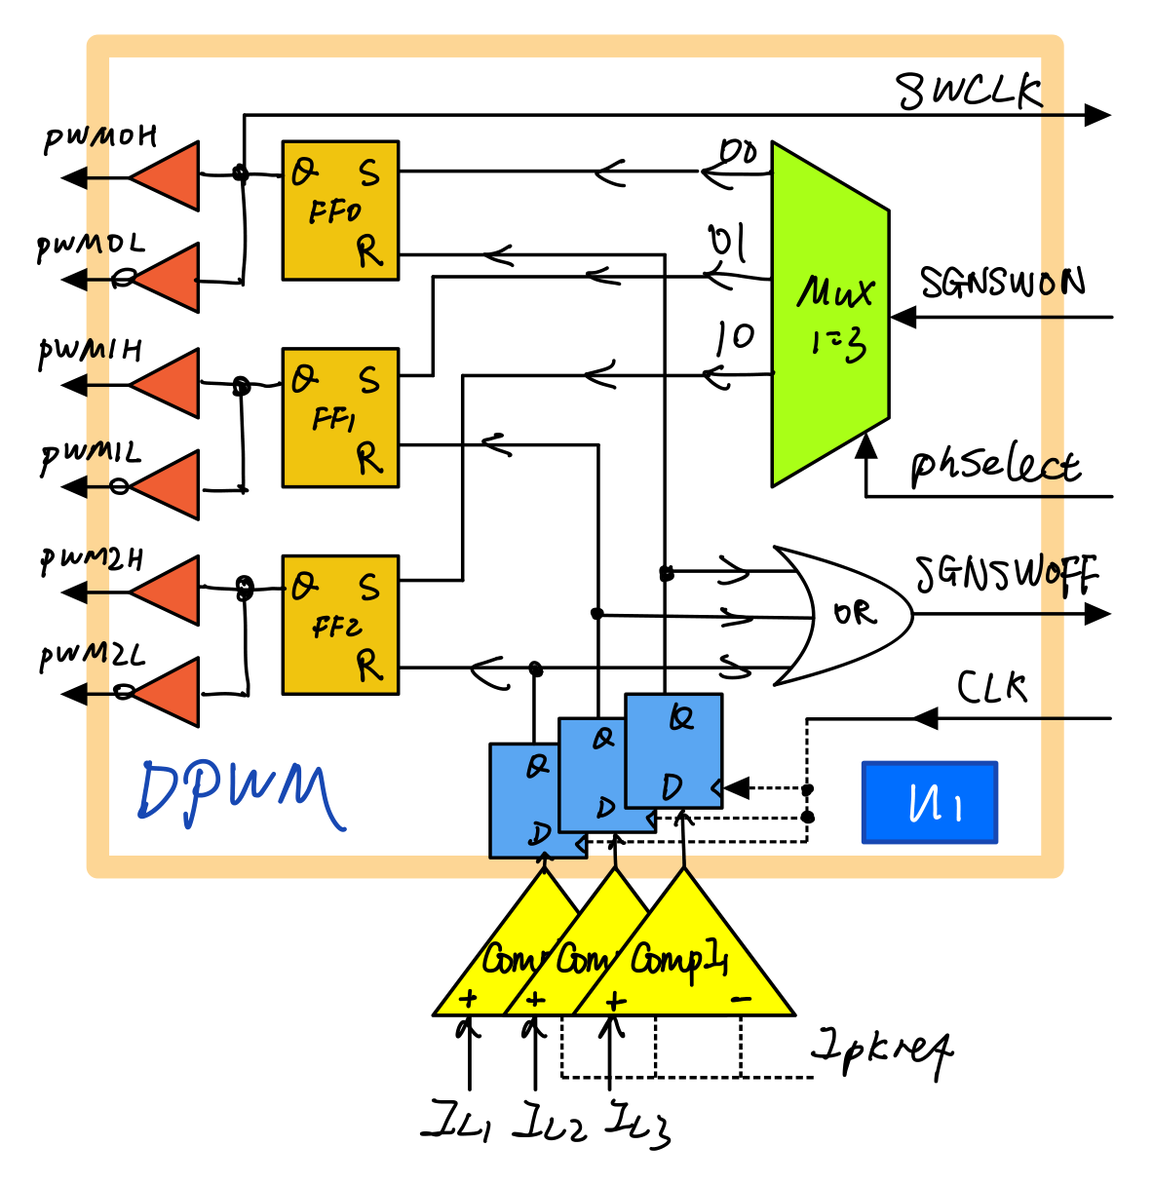
DPWM implementation
D-Flip Flop transformed the unsynchronized COMPI signal to synchronized signal;
SR latch controls the gate driver signals PWMnH/PWMnL;
The Multiplexer changes switching phase in turns by phslect signal;
The block returns SWCLK for switching period calculation and SGNSWOFF for state switch condition,
entity DPWM is
port(SGNSWON, CompI1, CompI2, CompI3: in std_logic;
PhSelect: in unsigned (1 downto 0);
SGNSWOFF: out std_logic;
SWCLK: out std_logic;
PWM0H,PWM0L,PWM1H,PWM1L,PWM2H,PWM2L: out std_logic);
END DPWM;
DPWM component structure

Slide 10
DPWM implementation
architecture structural OF DPWM IS
signal Dset0,Dset1,Dset2,Drest0,Drest1,Drest2: std_logic;
-- insert COMPONENT declarations
begin
SR0: entity SR_latch(sequential)
port map(Dset0 => Dset, Drest0 => Drest,
PWM0H => DQ, PWM0L => not DQ);
SR1: entity SR_latch(sequential)
port map(Dset1 => Dset, Drest1 => Drest,
PWM1H => DQ, PWM1L => not DQ);
SR2: entity SR_latch(sequential)
port map(Dset2 => Dset, Drest2 => Drest,
PWM2H => DQ, PWM2L => not DQ);
DFF0: entity D_FlipFlop(sequential)
port map(clk => clk, CompI1 => D, Drest0=> Q);
DFF1: entity D_FlipFlop(sequential)
port map(clk => clk, CompI2 => D, Drest1=> Q);
DFF2: entity D_FlipFlop(sequential)
port map(clk => clk, CompI3 => D, Drest2=> Q);
MUX0: entity MUX_1to3(sequential)
port map(PhSelect => MUXsel, Dset0 =>out0, Dset1 =>out1, Dset2 =>out1);
SWCLK <= PWM0H;
SGNSWOFF <= (Drest0 or Drest1 or Drest2);
end structural;

Slide 11
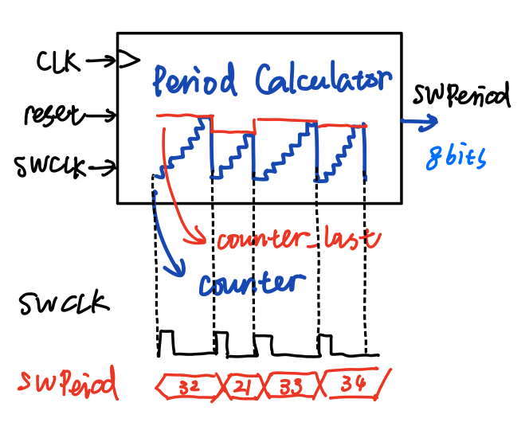
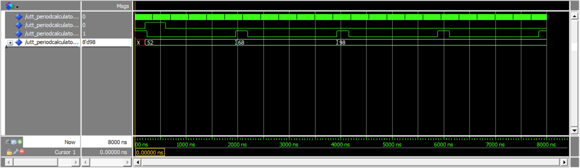
Period Calculator implementation
library ieee;
use ieee.std_logic_1164.all;
use ieee.std_logic_unsigned.all;
entity PeriodCalculator is
generic(CounterWidth: integer:= 8;
SWPeriod_norm: std_logic_vector:=B"00110100");
port(reset:IN std_logic;
CLK: IN std_logic;
SWCLK:IN std_logic;
SWPeriod: OUT std_logic_vector(CounterWidth-1 downto 0));
END PeriodCalculator;
architecture behavioral OF PeriodCalculator IS
begin
process (clk,reset,SWCLK)
variable counter :std_logic_vector(CounterWidth-1 downto 0);
variable counter_last :std_logic_vector(CounterWidth-1 downto 0);
begin
if reset='1'then
counter:=(others=>'0');
counter_last:=SWPeriod_norm;
SWPeriod<=SWPeriod_norm;
else
if rising_edge(SWCLK) then
counter_last:=counter;
counter:=(others=>'0');
else
if rising_edge(clk) then
counter:=counter+1;
end if;
SWPeriod <= counter_last;
end if;
end if;
END PROCESS;
END behavioral;
Period Calculator transform the switching signal to switching-period signal(SWPeriod) by counting the clock cycle between two turn-on signals (SWCLK)
Main idea: use a counter_last to register the value just before the counter come back zero

Slide 12
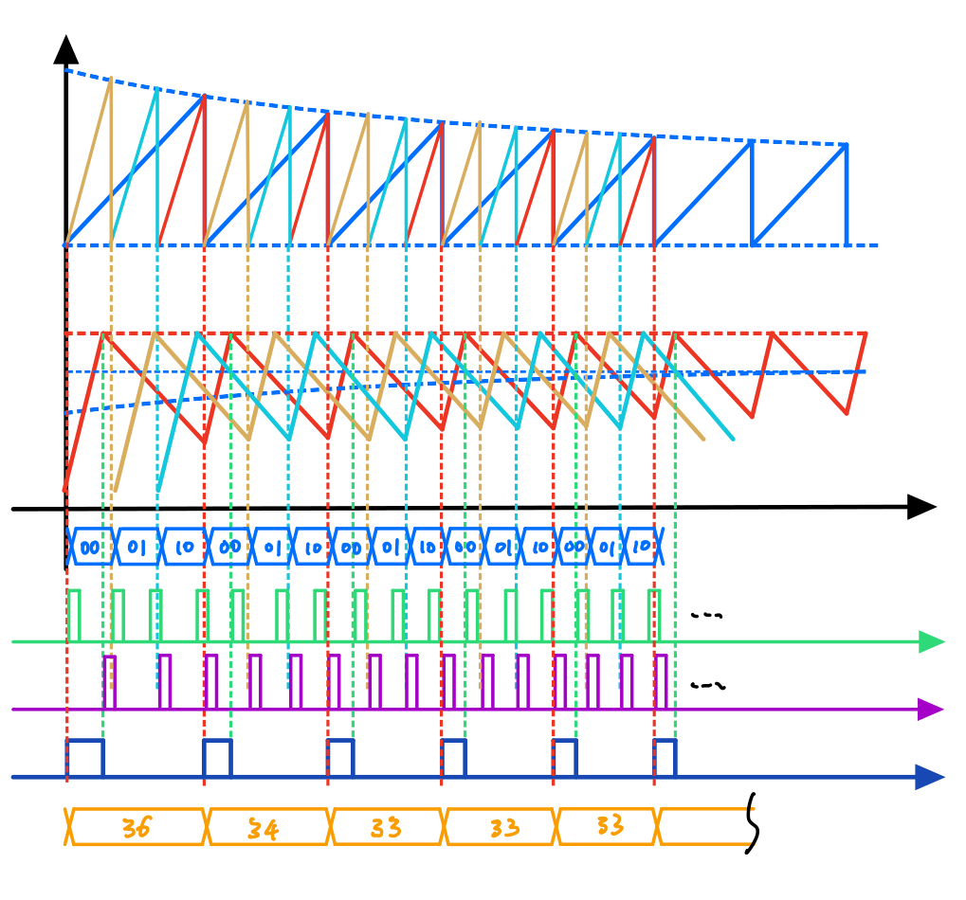

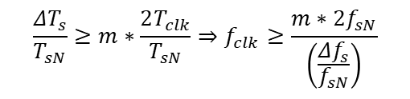


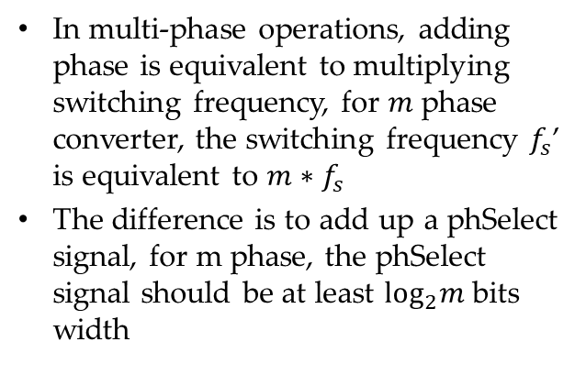



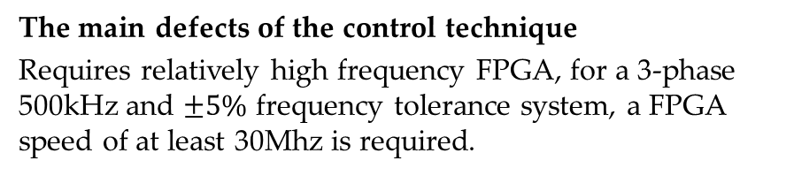

Multi-phase control unit implementation
$$V_{DACV}$$
In multi-phase operations, adding phase is equivalent to multiplying switching frequency, for $m$ phase converter, the switching frequency $f_{s}$’ is equivalent to $m∗f_{s}$
The difference is to add up a phSelect signal, for m phase, the phSelect signal should be at least $\log_{2}m$ bits width
$$I_{L}$$
$$PhSelect$$
$$SGNSWON$$
$$SGNSWOFF$$
Minimum FPGA clock frequency
According to Nyquist - Shannon Theorem, the sampling should be at least two times the frequency bandlimited, that is, the least frequency variation we want to detect
$$SWCLK$$
$$SWPeriod$$
Key waveform of control architecture applied to a 3-phase buck converter
The main defects of the control technique
Requires relatively high frequency FPGA, for a 3-phase 500kHz and $±5\%$ frequency tolerance system, a FPGA speed of at least 30Mhz is required.
$$\frac{{ΔT}_{s}}{T_{sN}}≥m∗\frac{2T_{clk}}{T_{sN}}⇒f_{clk}≥\frac{m∗2f_{sN}}{\left(\frac{{Δf}_{s}}{f_{sN}}\right)}$$
FPGA device (Xilinx, Virtex XCV 50) operated at 50MHz; four D/A converters 7bits

Slide 13
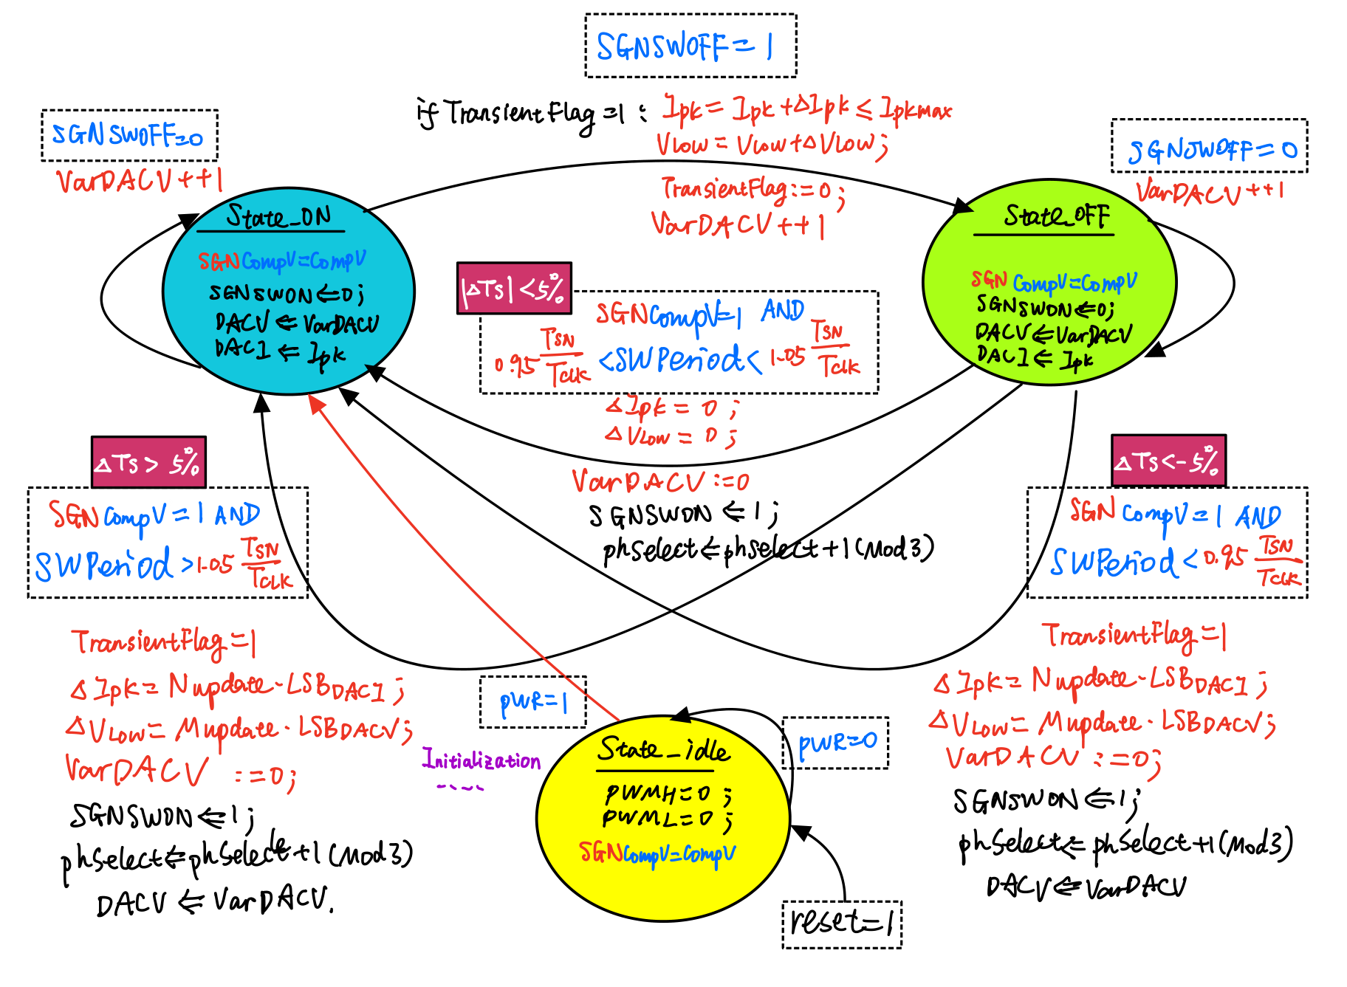
Control Unit with AVP technique FSM algorithm

Slide 14
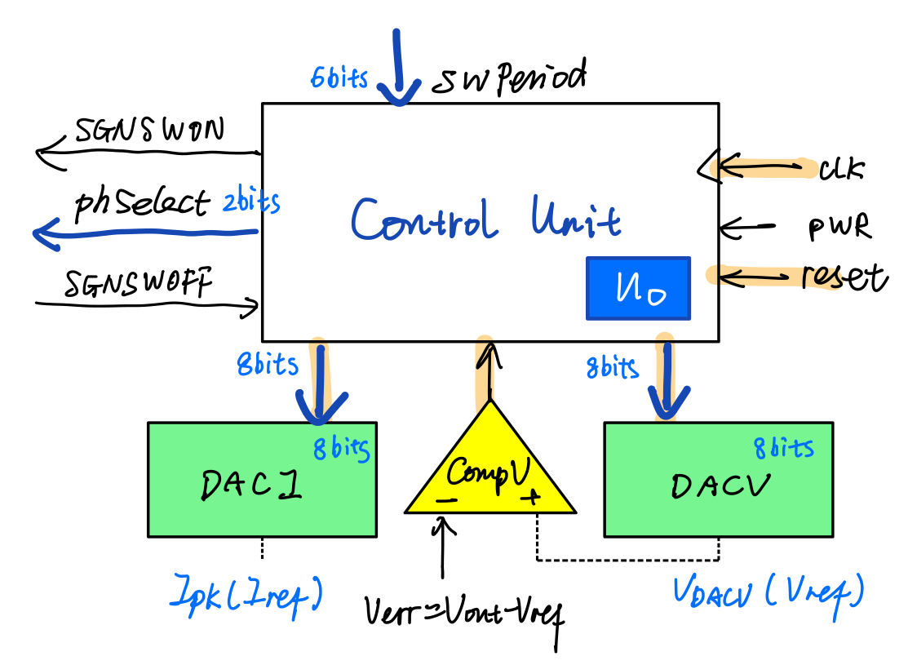
Control Unit with AVP technique FSM algorithm
architecture algorithm of control_unit is
type state_type is (state_on, state_off, state_idle);
signal state: state_type;
signal SGNcompV: std_logic:='0';
begin
process(clk)
begin
if rising_edge(clk) then
SGNCompV<=CompV;
end if;
end process;
process(clk,reset)
Variable VarSGNSWON :std_logic:='0';
Variable VarDACV :std_logic_vector(DACWidth-1 downto 0):=B"00000000";
Variable VarDACI :std_logic_vector(DACWidth-1 downto 0):=B"00000000";
Variable TrasientFlag :std_logic:='0';
Variable delt_Ipk,delt_Vlow :std_logic_vector(DACWidth-1 downto 0):=B"00000000";
Variable VarPhSelect:std_logic_vector(1 downto 0):=B"00";
begin
if rising_edge(clk) then
if reset = '1' then state <= state_idle;
else
case state is
when state_idle =>
if PWR = '1' then
state <= state_on;
else state <= state_idle;
end if;
when state_on =>
if rising_edge(SGNSWOFF)
then if TrasientFlag='1' then
VarDACV := VarDACV+delt_Vlow;
VarDACI := VarDACI+delt_Ipk;
TrasientFlag := '0';
end if;
state <= state_off;
end if;
when state_off =>
if rising_edge(SGNCompV)AND(SWPeriod<B"01011111") then --SWPeriod<95
TrasientFlag := '1';
TrasientFlag := '1';
state <= state_on;
else
if rising_edge(SGNCompV)AND(SWPeriod>B"01101001") then --SWPeriod>105
TrasientFlag := '1';
state <= state_on;
else
if rising_edge(SGNCompV)AND(SWPeriod>="01011111")AND(SWPeriod<=B"01101001") then
TrasientFlag := '0';
delt_Vlow:= B"00000000";
delt_Ipk:= B"00000000";
VarDACV:=B"00000000";
state <= state_on;
end if;
end if;
end if;
end case;
SGNSWON <= VarSGNSWON;
PhSelect <= VarPhSelect;
DACV <= VarDACV;
DACI <= VarDACI;
end if;
end if;
end process;
end algorithm;
library IEEE;
use IEEE.STD_LOGIC_1164.ALL;
use ieee.std_logic_unsigned.ALL;
entity control_unit is
generic(DACWidth: integer := 8;
CounterWidth: integer:= 8);
port(reset, clk, PWR: in std_logic;
SWPeriod: in std_logic_vector(CounterWidth-1 downto 0);
SGNSWON: out std_logic;
SGNSWOFF: in std_logic;
PhSelect: out std_logic_vector(1 downto 0);
DACV,DACI: out std_logic_vector(DACWidth-1 downto 0);
CompV: in std_logic);
end control_unit;
end if;
end process;
end algorithm;

Slide 15
Assembling the digital controller
architecture structural of processor is
--- -- COMPONENT declarations (DATAPATH & CONTOL UNIT)
signal SWCLK, SGNSWON, SGNSWOFF: std_logic;
signal PhSelect: std_logic_vector(2 downto 0);
signal SWPeriod: std_logic_vector(CounterWidth-1 downto 0);
Begin
U0: control_unit
generic map (DACWidth => DACWidth, CounterWidth => CounterWidth)
port map(reset=>reset,CLK=>CLK,PWR=>PWR,
SWPeriod=>SWPeriod,
SGNSWON=>SGNSWON,SGNSWOFF=>SGNSWOFF,PhSelect=>PhSelect,
DACI=>DACI,DACV=>DACV,CompV=>CompV);
U1: DPWM
port map(SGNSWON=>SGNSWON,SGNSWOFF=>SGNSWOFF,PhSelect=>PhSelect,
CLK=>CLK,SWCLK=>SWCLK,
CompI1=>CompI1, CompI2=>CompI2, CompI3=>CompI3,
PWM0H=>PWM0H,PWM0L=>PWM0L,PWM1H=>PWM1H,PWM1L=>PWM1L,PWM2H=>PWM2H,PWM2L=>PWM2L);
U2: period_calculator
generic map (CounterWidth => CounterWidth)
port map(reset=>reset,CLK=>CLK,SWCLK=>SWCLK,SWPeriod=>SWPeriod);
end structural;

Slide 16
Conclusion
FPGA is ideal tools to achieve multi-model control techniques to improve the dynamic performance with very fast transient response
FPGA is flexible for fully reconfigurable digital architecture, as well as calculation sparse algorithm, but in calculation dense algorithm, large spaces and clock speed is required. one solution is to use FPGA to do signal process and PWM generation, and let the calculation process to general proposed processors
For multi-phase topology, FPGA is powerful for signal reproduction and synchronization because its concurrent feature

